Slide 1
McCulloch Pitts Neuron - Perceptron
Prakash P VIT , Chennai

Slide 2
Road Map
What can a perceptron be used for ?
Perceptron Algorithm

Slide 3
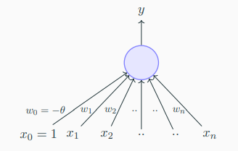
Perceptron as a binary classifier
x₁ = isActorRajinikanth
x₂ = isGenreFamily
x₃ = isDirectorKSRavi
x₄ = imdbRating(scaled to 0 to 1)
... ...
x_{n} = criticsRating(scaled to 0 to 1)
Let us reconsider our problem of deciding whether to watch a movie or not
Suppose we are given a list of m movies and a label (class) associated with each movie indicating whether the user liked this movie or not : binary decision
Further, suppose we represent each movie with n features (some boolean, some real valued)
We will assume that the data is linearly separable and we want a perceptron to learn how to make this decision
In other words, we want the perceptron
to find the equation of this separating plane (or find the values of w₀, w₁, w₂, .., w_{m})

Slide 4
Perceptron Algorithm
Algorithm: Perceptron Learning Algorithm
P ← inputs with label 1;

Slide 5
Perceptron Algorithm
Algorithm: Perceptron Learning Algorithm
P ← inputs with label 1;
N ← inputs with label 0;

Slide 6
Perceptron Algorithm
Algorithm: Perceptron Learning Algorithm
P ← inputs with label 1;
N ← inputs with label 0;
Initialize w randomly;

Slide 7
Perceptron Algorithm
Algorithm: Perceptron Learning Algorithm
P ← inputs with label 1;
N ← inputs with label 0;
Initialize w randomly;
while !convergence do
end

Slide 8

Perceptron Algorithm
Algorithm: Perceptron Learning Algorithm
P ← inputs with label 1;
N ← inputs with label 0;
Initialize w randomly;
while !convergence do
Pick random x ∈ P ∪ N ;
if x ∈ P and $\sum_{i=0}^{n}{wi ∗xi<0 then }$
w = w + x;
end
end

Slide 9
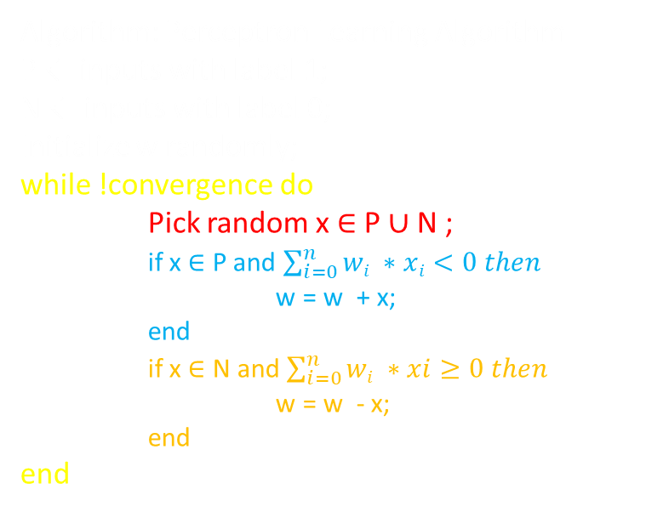
Perceptron Algorithm
Algorithm: Perceptron Learning Algorithm
P ← inputs with label 1;
N ← inputs with label 0;
Initialize w randomly;
while !convergence do
Pick random x ∈ P ∪ N ;
if x ∈ P and $\sum_{i=0}^{n}{wi ∗xi<0 then }$
w = w + x;
end
if x ∈ N and $\sum_{i=0}^{n}{wi ∗xi≥0 then }$
w = w - x;
end
end

Slide 10
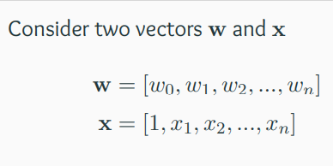
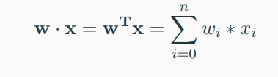
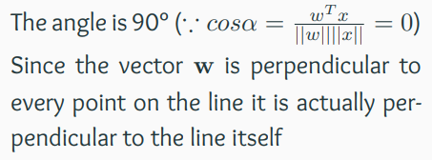
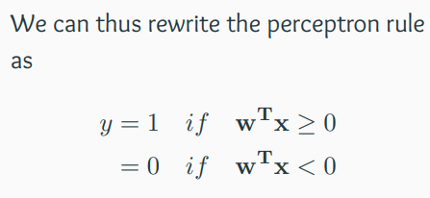

Perceptron Algorithm
Algorithm: Perceptron Learning Algorithm
P ← inputs with label 1;
N ← inputs with label 0;
Initialize w randomly;
while !convergence do
Pick random x ∈ P ∪ N ;
if x ∈ P and $\sum_{i=0}^{n}{wi ∗xi<0 then }$
w = w + x;
end
if x ∈ N and $\sum_{i=0}^{n}{wi ∗xi≥0 then }$
w = w - x;
end
end
We are interested in finding the line
w^{T}x = 0 which divides the input space
into two halves
Every point (x) on this line satisfies the equation w^{T}x = 0
What can you tell about the angle (α) between w and any point (x) which lies
on this line ?

Slide 11
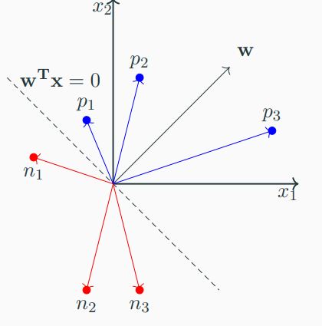
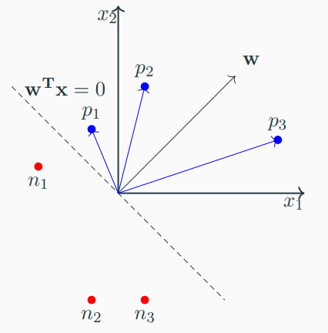
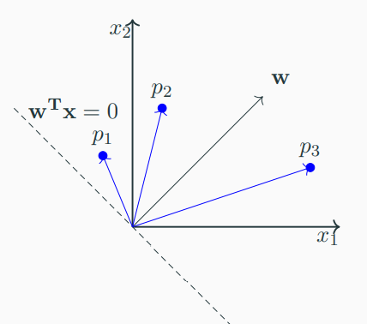
Perceptron Algorithm
Consider some points (vectors) which lie in the
positive half space of this line (i.e., w^{T}x ≥ 0)
Algorithm: Perceptron Learning Algorithm
P ← inputs with label 1;
N ← inputs with label 0;
Initialize w randomly;
while !convergence do
Pick random x ∈ P ∪ N ;
if x ∈ P and $\sum_{i=0}^{n}{wi ∗xi<0 then }$
w = w + x;
end
if x ∈ N and $\sum_{i=0}^{n}{wi ∗xi≥0 then }$
w = w - x;
end
end
What will be the angle between any such vector and w ?
Obviously, less than 90°
What about points (vectors) which lie in the negative half space of this line (i.e., w^{T}x < 0)
What will be the angle between any such vector and w ?
Obviously, greater than 90°

Slide 12
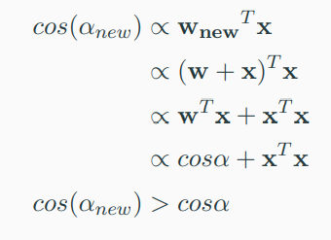
Perceptron Algorithm
For x ∈ P if w.x < 0 then it means
that the angle (α) between this x
and the current w is greater than
90° (but we want α to be less than
90°)
Algorithm: Perceptron Learning Algorithm
P ← inputs with label 1;
N ← inputs with label 0;
Initialize w randomly;
while !convergence do
Pick random x ∈ P ∪ N ;
if x ∈ P and $\sum_{i=0}^{n}{wi ∗xi<0 then }$
w = w + x;
end
if x ∈ N and $\sum_{i=0}^{n}{wi ∗xi≥0 then }$
w = w - x;
end
end
What happens to the new angle
(α_{new}) when w_{new} = w + x

Slide 13
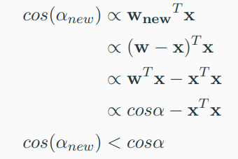
Perceptron Algorithm
For x ∈ N if w.x ≥ 0 then it means that the angle (α) between this x and the current w is less than 90° (but we want α to be greater than 90°)
Algorithm: Perceptron Learning Algorithm
P ← inputs with label 1;
N ← inputs with label 0;
Initialize w randomly;
while !convergence do
Pick random x ∈ P ∪ N ;
if x ∈ P and $\sum_{i=0}^{n}{wi ∗xi<0 then }$
w = w + x;
end
if x ∈ N and $\sum_{i=0}^{n}{wi ∗xi≥0 then }$
w = w - x;
end
end
What happens to the new angle
(α_{new}) when w_{new} = w − x

Slide 14
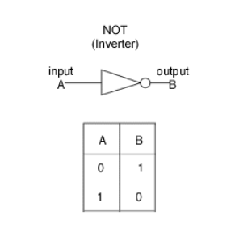
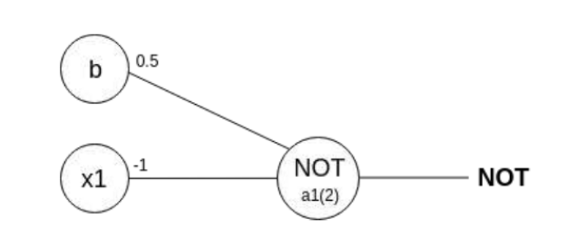
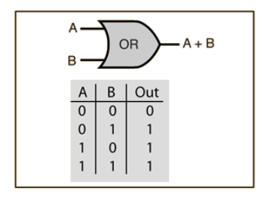
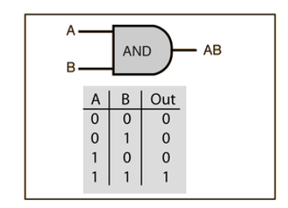
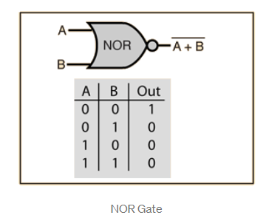
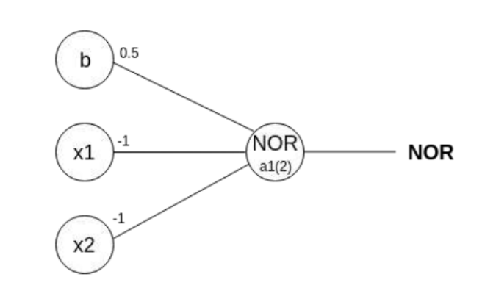
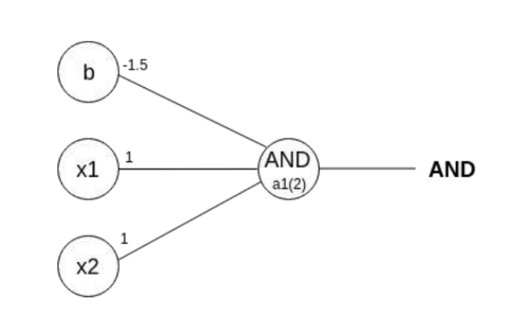
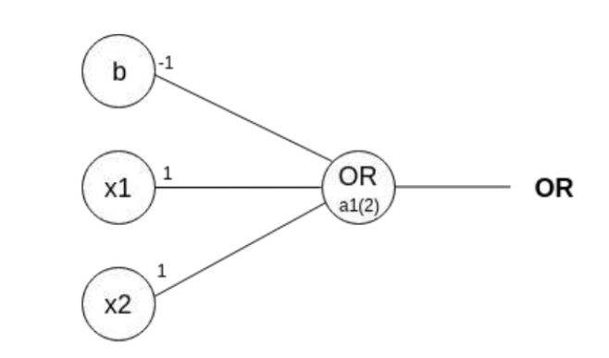
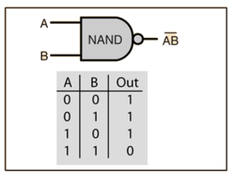
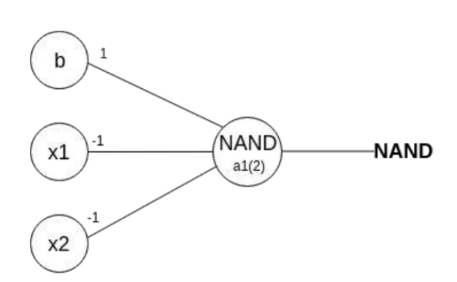
Perceptron Algorithm
initializing w1, w2, as 1 and w0 as –1
initializing w1, w2, as 1 and w0 as –1

Slide 15
So far,
What about non-boolean (say, real) inputs?
Real valued inputs are allowed
No, we can learn the threshold
Do we always need to hand code the threshold?
Are all inputs equal? What if we want to assign more weight (importance) to some
inputs?
A perceptron allows weights to be assigned to inputs
What about functions which are not linearly separable ?
Not possible with a single perceptron but we will see how to handle this

Slide 16
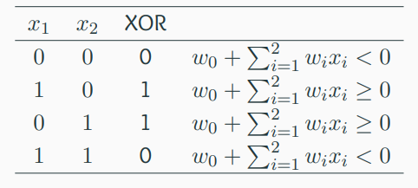
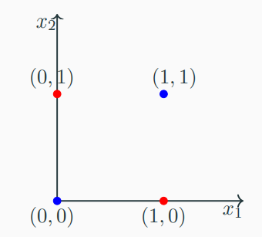
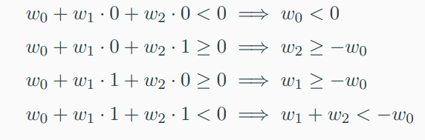
what do we do about functions which are not linearly separable ?
The fourth condition contradicts conditions 2 and 3
Hence we cannot have a solution to this set of inequalities
XOR is not linearly separable using single layer perceptron
What about XNOR gate (sometimes ENOR, EXNOR or NXOR and pronounced as Exclusive NOR) ?

Slide 17
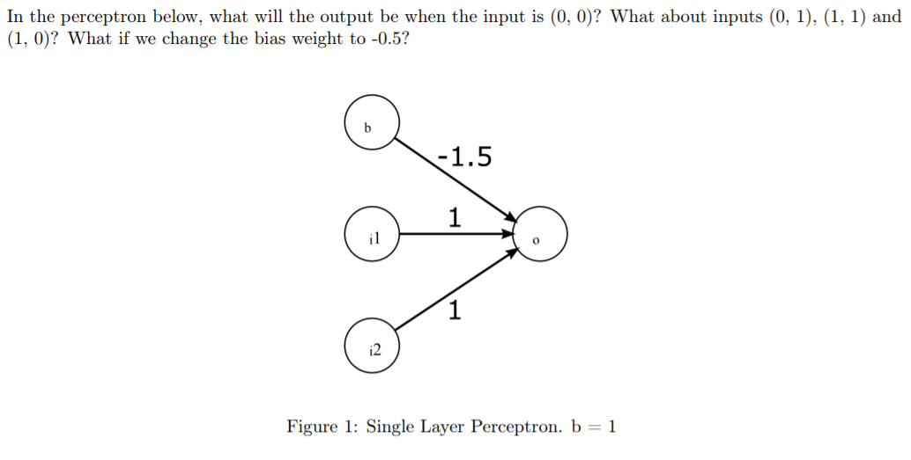
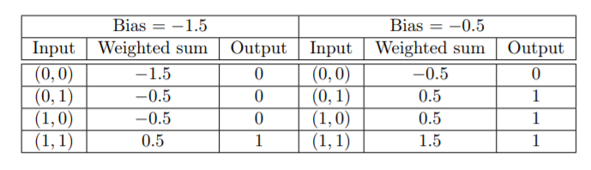
Example

Slide 18
References
https://towardsdatascience.com/perceptron-learning-algorithm-d5db0deab975
https://www.cse.iitm.ac.in/~miteshk/CS6910.html#schedule
https://machinelearningmastery.com/perceptron-algorithm-for-classification-in-python/
https://www.studocu.com/in/document/birla-institute-of-technology-and-science-pilani/software-systems/neural-representation-of-and-or-not-xor-and-xnor-logic-gates-perceptron-algorithm/4549004

Slide 19
Thanks

